Slide 1
Introduction to Data Science
John P Dickerson
Lecture #21 – 11/5/2019
CMSC320
Tuesdays & Thursdays
5:00pm – 6:15pm

Slide 2
Today’s Lecture
Data collection
Data processing
Exploratory analysis
&
Data viz
Analysis, hypothesis testing, & ML
Insight & Policy Decision

Slide 3
Today’s lecture
More nonlinear classification/regression methods
Decision trees & random forests in Scikit-Learn
K-Nearest Neighbors (KNN)
Support Vector Machines (SVMs)
Thanks to: Hector Corrada Bravo (UMD), Panagiotis Tsaparas (U of I), Oliver Schulte (SFU)

Slide 4
Decision Trees in Scikit
from sklearn.datasets import load_iris
from sklearn import tree
# Load a common dataset, fit a decision tree to it
iris = load_iris()
clf = tree.DecisionTreeClassifier()
clf = clf.fit(iris.data, iris.target)
Trains a decision tree using default hyperparameters (attribute chosen to split on either Gini or entropy, no max depth, etc)
# Predict most likely class
clf.predict([[2., 2.]])
# Predict PDF over classes (%training samples in leaf)
clf.predict_proba([[2., 2.]])

Slide 5
Visualizing a decision tree
from IPython.display import Image
dot_data = tree.export_graphviz(clf,
out_file=None,
feature_names=iris.feature_names,
class_names=iris.target_names,
filled=True, rounded=True)
graph = pydotplus.graph_from_dot_data(dot_data)
Image(graph.create_png())

Slide 6
Random Forests
Decision trees are very interpretable, but may be brittle to changes in the training data, as well as noise
Random forests are an ensemble method that:
Resamples the training data;
Builds many decision trees; and
Averages predictions of trees to classify.
This is done through bagging and random feature selection

Slide 7
Bagging
Bagging: Bootstrap aggregation
Resampling a training set of size n via the bootstrap:
Sample with replacement n elements
General scheme for random forests:
Create B bootstrap samples, {Z₁, Z₂, …, Z_{B}}
Build B decision trees, {T₁, T₂, …, T_{B}}, from {Z₁, Z₂, …, Z_{B}}
Classification/Regression:
Each tree T_{j} predicts class/value y_{j}
Return average 1/B Σ_{j={1,...,B}} y_{j} for regression, or majority vote for classification

Slide 8
obs_id | ft_1 | ft_2
1 | 12.2 | puppy
2 | 34.5 | dog
3 | 8.1 | cat
Original training dataset (Z):
B Bootstrap samples Z_{j}
Z₁
Z₂
Z_{B}
obs_id | ft_1 | ft_2
3 | 8.1 | cat
2 | 34.5 | dog
3 | 8.1 | cat
obs_id | ft_1 | ft_2
1 | 12.2 | puppy
2 | 34.5 | dog
1 | 12.2 | puppy
obs_id | ft_1 | ft_2
1 | 12.2 | puppy
1 | 12.2 | puppy
3 | 8.1 | cat
T₁
T₂
T_{j}
T_{B}
Aggregate/Vote
Class estimate or predicted value

Slide 9
Random Attribute selection
We get some randomness via bootstrapping
We like this! Randomness increases the bias of the forest slightly at a huge decrease in variance (due to averaging)
We can further reduce correlation between trees by:
For each tree, at every split point …
… choose a random subset of attributes …
… then split on the “best” (entropy, Gini) within only that subset

Slide 10
Random forests in scikit-learn
from sklearn.ensemble import RandomForestClassifier
# Train a random forest of 10 default decision trees
X = [[0, 0], [1, 1]]
Y = [0, 1]
clf = RandomForestClassifier(n_estimators=10)
clf = clf.fit(X, Y)
Can we get even more random?!
Extremely randomized trees (ExtraTreesClassifier) do bagging, random attribute selection, but also:
At each split point, choose random splits
Pick the best of those random splits
Similar bias/variance performance to RFs, but can be faster computationally

Slide 11
K-Nearest Neighbors

Slide 12
Nearest Neighbor Classifiers
Basic idea:
If it walks like a duck, quacks like a duck, then it’s probably a duck
Compute Distance
Test Record
Training Records
Choose k of the “nearest” records

Slide 13
Nearest-Neighbor Classifiers
Requires three things
The set of stored records
Distance Metric to compute distance between records
The value of k, the number of nearest neighbors to retrieve
To classify an unknown record:
Compute distance to other training records
Identify k nearest neighbors
Use class labels of nearest neighbors to determine the class label of unknown record (e.g., by taking majority vote)

Slide 14
Definition of Nearest Neighbor
K-nearest neighbors of a record x are data points that have the k smallest distances to x

Slide 15
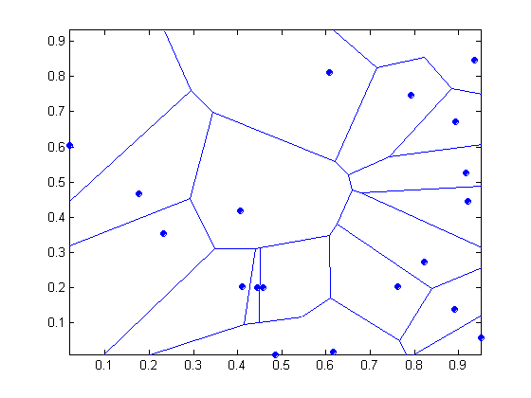
1-Nearest neighbor
Voronoi Diagram defines the classification boundary
The area takes the class of the green point

Slide 16
Nearest Neighbor Classification
Compute distance between two points:
Euclidean distance
Determine the class from nearest neighbor list
Take the majority vote of class labels among the k-nearest neighbors
Weight the vote according to distance
E.g., weight factor w = 1/d²

Slide 17
Nearest Neighbor Classification…
Choosing the value of k:
If k is too small, sensitive to noise points
If k is too large, neighborhood may include points from other classes

Slide 18
Nearest Neighbor Classification…
Scaling issues
Attributes may have to be scaled to prevent distance measures from being dominated by one of the attributes
Example:
height of a person may vary from 1.5m to 1.8m
weight of a person may vary from 90lb to 300lb
income of a person may vary from $10K to $1M
Standardize variables, like in Mini-Project #2.

Slide 19
Nearest Neighbor Classification…
Problem with Euclidean measure:
High dimensional data
The curse of dimensionality – data becomes sparse relative to the total volume of the space, distance metrics “lose meaning”
Can produce counter-intuitive results
1 1 1 1 1 1 1 1 1 1 1 0
1 0 0 0 0 0 0 0 0 0 0 0
vs
0 1 1 1 1 1 1 1 1 1 1 1
0 0 0 0 0 0 0 0 0 0 0 1
d = 1.4142
d = 1.4142
Solution: Normalize the vectors to unit length

Slide 20
Nearest neighbor Classification…
k-NN classifiers are lazy learners
It does not build models explicitly
Unlike eager learners such as decision tree induction and rule-based systems
Classifying unknown records are relatively expensive
Naïve algorithm: O(n)
Need for structures to retrieve nearest neighbors fast
The Nearest Neighbor Search problem
CMSC420 covers spatial data structures extensively

Slide 21
Nearest Neighbor Search
Two-dimensional kd-trees:
A data structure for answering nearest neighbor queries in R²
kd-tree construction algorithm
Select the x or y dimension (alternating between the two)
Partition the space into two with a line passing from the median point
Repeat recursively in the two partitions as long as there are enough points
Can quickly query the tree for nearest neighbors by finding an incumbent best and pruning large chunks of the tree away

Slide 22
K-NN: Advantages
Simple technique that is easily implemented
Building model is cheap
Extremely flexible classification scheme
Well suited for:
Multi-modal classes
Records with multiple class labels
Can sometimes be the best method
Michihiro Kuramochi and George Karypis, Gene Classification using Expression Profiles: A Feasibility Study, International Journal on Artificial Intelligence Tools. Vol. 14, No. 4, pp. 641-660, 2005
K nearest neighbor outperformed SVM for protein function prediction using expression profiles

Slide 23
K-NN: Disadvantages
Classifying unknown records are relatively expensive
Requires distance computation of k-nearest neighbors
Computationally intensive, especially when the size of the training set grows
Accuracy can be severely degraded by the presence of:
Noisy or irrelevant features
High-dimensional space
Choosing the wrong distance metric
Choosing the wrong k

Slide 24
KNN Classification in Scikit-Learn
from sklearn import neighbors, datasets
# Load a common dataset, fit a 15-NN classifier to it
iris = datasets.load_iris()
X = iris.data[:, :2] # take the first two features
y = iris.target
clf = neighbors.KNeighborsClassifier( 15, weights=‘uniform’)
clf.fit(X, y)
Uniform weights
1/d² weights

Slide 25
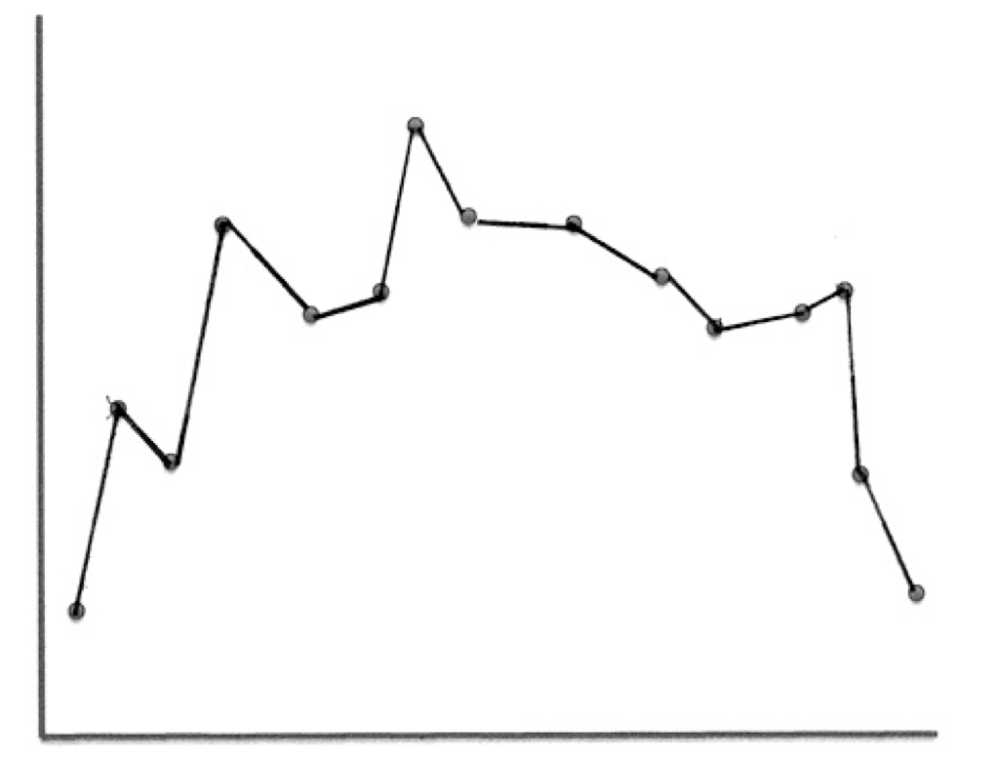
Local Regression
Basic Idea: To predict a target value y for data point x, apply interpolation/regression to the neighborhood of x.
Simplest version: connect the dots.
Notes:
Doesn’t generalize well for noisy data (outliers).

Slide 26
k-nearest neighbor regression
Connect the dots uses k = 2, fits a line.
Ideas for k =5.
Fit a line using linear regression.
Predict the average target value of the k points.
Notes:
What is k?

Slide 27
Local Regression With Kernels
Spikes in regression prediction come from in-or-out nature of neighborhood
Instead, weight examples as function of the distance
A homogenous kernel function maps the distance between two vectors to a number, usually in a nonlinear way. k(x,x’) = k(distance(x,x’))
Example: The quadratic kernel
Notes:
Legend: the arrrow shows the negated gradient, indicating the direction that produces steepest descent along the error surface

Slide 28
The Quadratic Kernel
k = 5
Let query point be x = 0.
Plot k(0,x’) = k(|x’|).
Notes:
weight vector = black. points in direction of red class. Add weight vector to misclssified feature vector to get new weight vector.

Slide 29
Kernel Regression
For each query point x_{q}, prediction is made as weighted linear sum: y(x_{q}) = w • x_{q.}
To find weights, solve the following regression on the k-nearest neighbors:

Slide 30
KNN Regression in Scikit-Learn
from sklearn.neighbors import KNeighborsRegressor
# Basic KNN regression in Scikit (interpolation)
X = [[0], [1], [2], [3]]
y = [0, 0, 1, 1]
neigh = KNeighborsRegressor( n_neighbors=2 )
neigh.fit(X, y)
print(neigh.predict([[1.5]]))
[ 0.5]
Also provides a variety of distance metrics, backing algorithms to find nearest neighbors, weight functions (down-weight points based on distance), etc.

Slide 31
Support Vector Machines

Slide 32
Support Vector Machines (SVM)
Find a linear hyperplane (decision boundary) that will separate the data

Slide 33
Support Vector Machines
One possible solution

Slide 34
Support Vector Machines
Other possible solutions

Slide 35
Support Vector Machines
Which one is better? B₁ or B₂? ??????????
How do you define better? ??????????

Slide 36
Support Vector Machines
Find hyperplane maximizes the margin → B₁ is better than B₂

Slide 37
Support Vector Machines
Notes:
w is the normal vector to the hyperplane

Slide 38
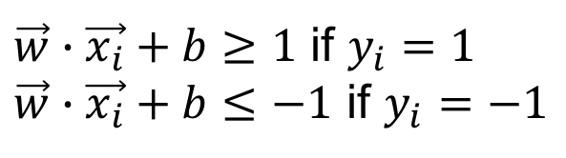
Support Vector Machines
We want to maximize:
Which is equivalent to minimizing:
But subject to the following constraints:
This is a constrained optimization problem
Numerical approaches to solve it (e.g., quadratic programming)
$\vec{w}∙\vec{x_{i}}+b≥1$ if $y_{i}=1$
$\vec{w}∙\vec{x_{i}}+b≤−1$ if $y_{i}=−1$

Slide 39
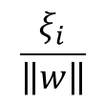
Support Vector Machines
What if the problem is not linearly separable?
Apply some sort of penalty
$$\frac{ξ_{i}}{\left\|w\right\|}$$

Slide 40
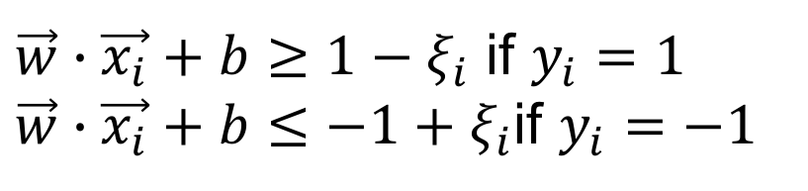
Support Vector Machines
What if the problem is not linearly separable?
Introduce slack variables
Need to minimize:
Subject to:
$\vec{w}∙\vec{x_{i}}+b≥1−ξ_{i}$ if $y_{i}=1$
$\vec{w}∙\vec{x_{i}}+b≤−1+ξ_{i}$if $y_{i}=−1$

Slide 41
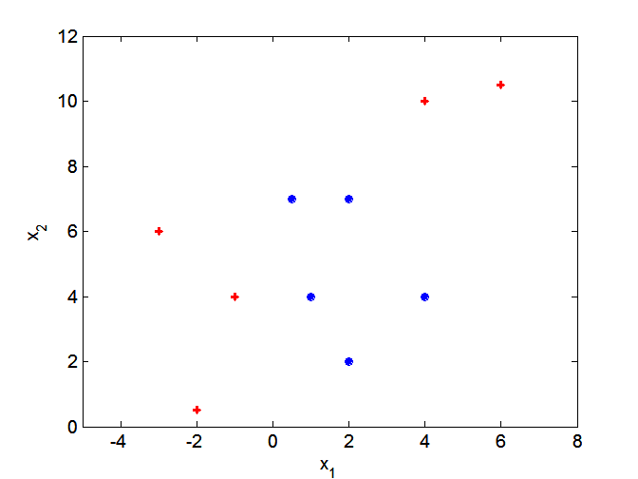
Nonlinear Support Vector Machines
What if the decision boundary is not linear?

Slide 42
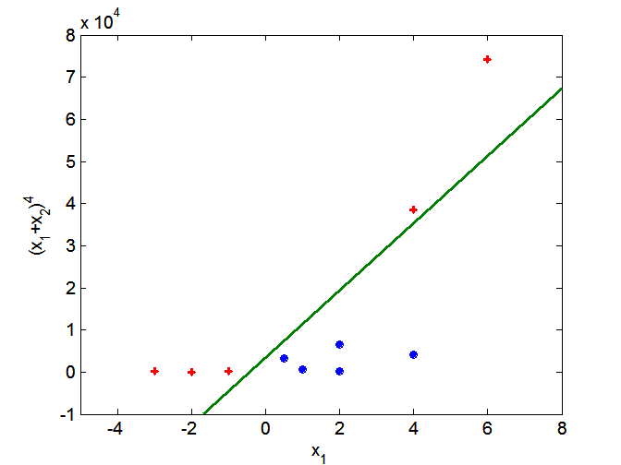
Nonlinear Support Vector Machines
Transform data into higher dimensional space

Slide 43
SVMs in Scikit-Learn
from sklearn import svm
# Fit a default SVM classifier to fake data
X = [[0, 0], [1, 1]]
y = [0, 1]
clf = svm.SVC()
clf.fit(X, y)
SVC(C=1.0, cache_size=200, class_weight=None, coef0=0.0, decision_function_shape=None, degree=3, gamma='auto', kernel='rbf', max_iter=-1, probability=False, random_state=None, shrinking=True, tol=0.001, verbose=False)
Lots of defaults used for hyperparameters – can use cross validation to search for good ones

Slide 44
Model Selection in Scikit-learn
from sklearn.model_selection import train_test_split
from sklearn.model_selection import GridSearchCV
from sklearn.metrics import classification_report
# ... Load some raw data into X and y ...
# Split the dataset in two equal parts
X_train, X_test, y_train, y_test = \
train_test_split(X, y, test_size=0.5, random_state=0)
# Pick values of hyperparameters you want to consider
tuned_parameters = [{'kernel': ['rbf'],
'gamma': [1e-3, 1e-4],
'C': [1, 10, 100, 1000]},
{'kernel': ['linear'],
'C': [1, 10, 100, 1000]}
]

Slide 45
Model Selection in Scikit-learn
# Perform a complete grid search + cross validation
# for each of the hyperparameter vectors
clf = GridSearchCV(SVC(C=1),
tuned_parameters,
cv=5,
scoring=‘precision’)
clf.fit(X_train, y_train)
# Now that you’ve selected good hyperparameters via CV,
# and trained a model on your training data, get an
# estimate of the “true error” on your test set
y_true, y_pred = y_test, clf.predict(X_test)
print(classification_report(y_true, y_pred))

